Slide 1

North-Point Software Production Company
Dimple Krishna Chintana

Slide 2
North Point Software Company
North Point software company sells education and gaming software.
North Point's key assets are customers.
Tied up with a third party and came up with a new wish list.
Expand its customer base, North Point Company has recently joined a consortium listing.
The consortium allows the mailing list of names drawn from the pool list of customers.
Totals over 5,000,000 names so they are allowed to pick 200,000 names out of this list for mailing.
By using the names members are allowed to do a predictive model on the records in the pool so they can choose a better job of selecting customers from the pool.

Slide 3
Business goal
The primary goal could be to maximize the profitability of their mailing.
Efficiently targeting potential customers who are more likely to make purchases.

Slide 4
Data Preprocessing
Attributes: This data set consists of 2000 observations with 25 columns with 2 outcome variables purchase and spending. Along 15 source columns.
While exploring data, can take part in checking missing values and checking NA’s
In the process of analyzing data to understand customer behavior and predict purchasing patterns, here are EDA to explain.

Slide 5
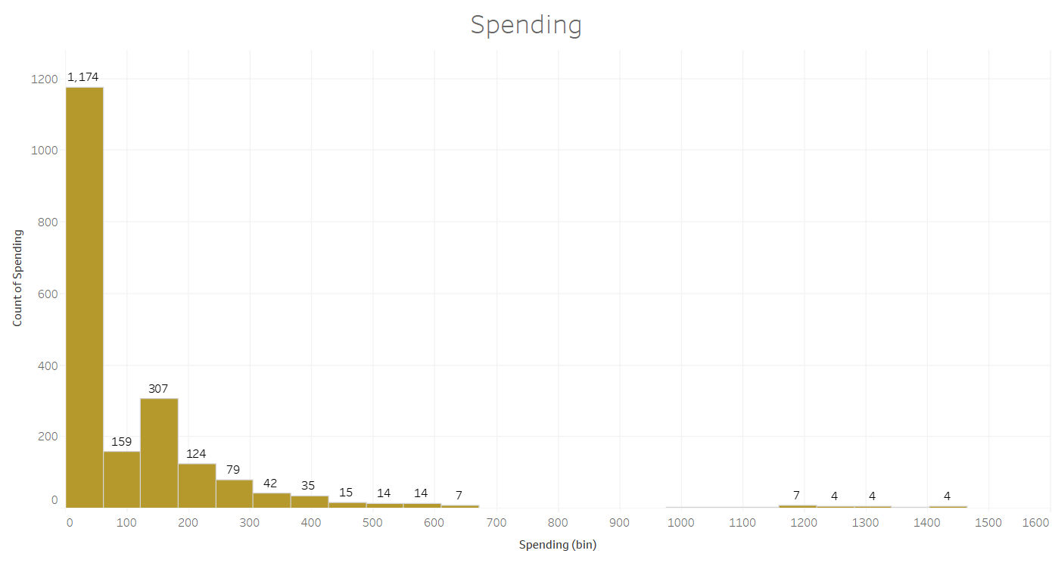
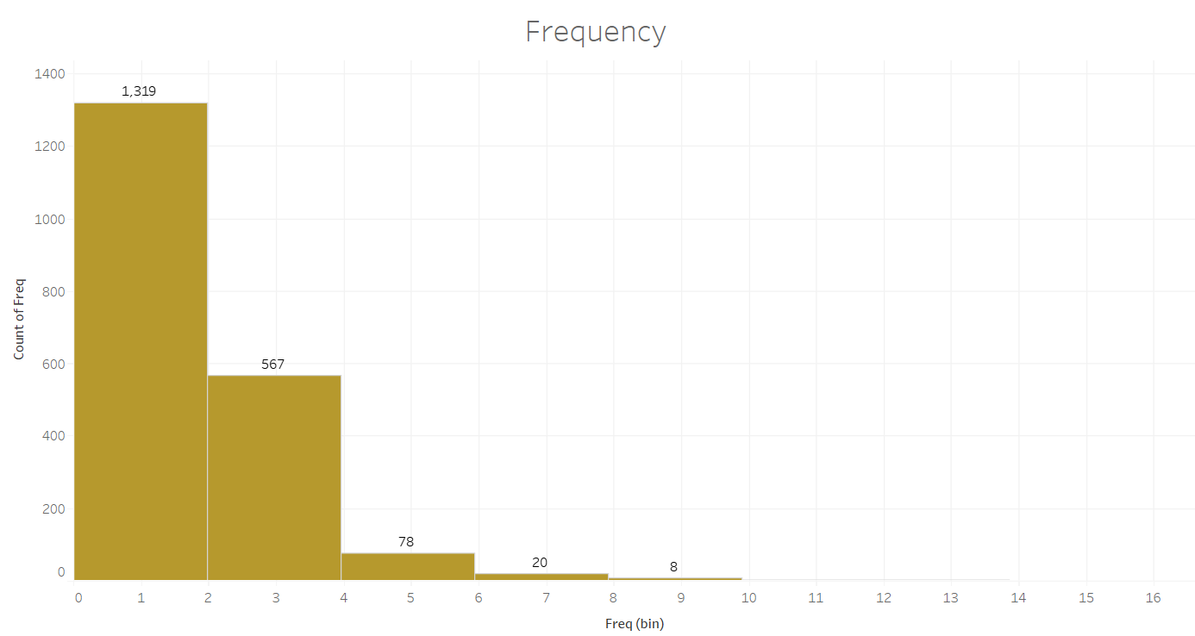
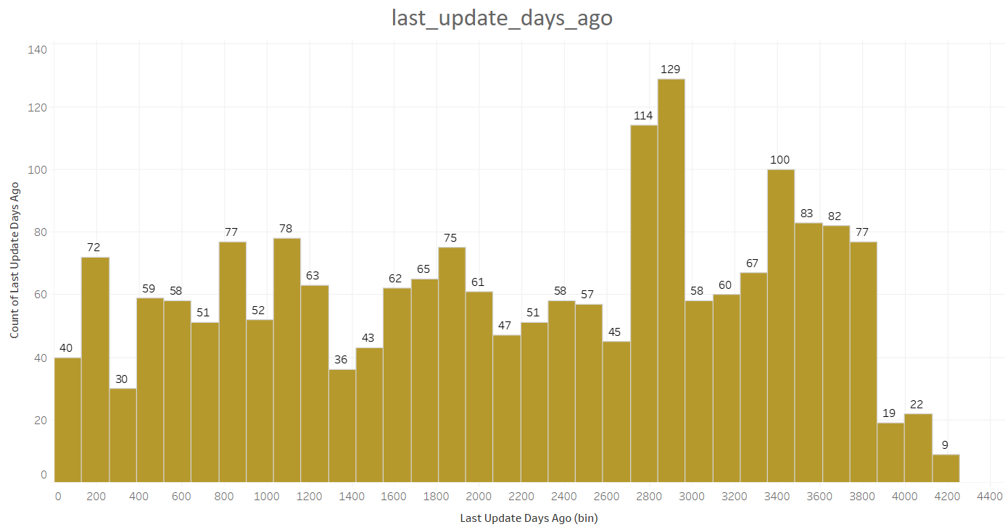
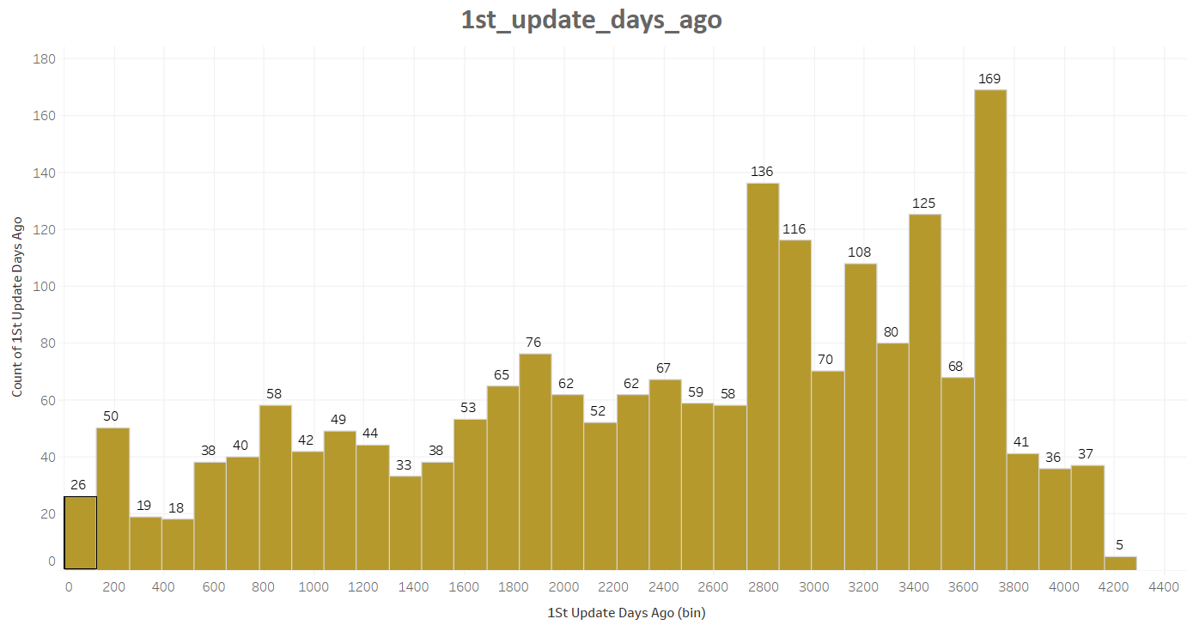
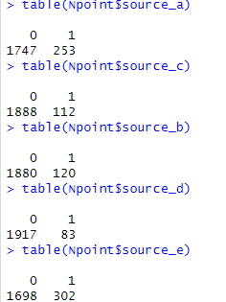
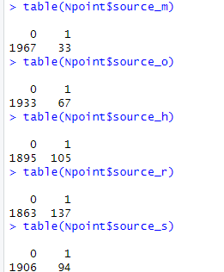
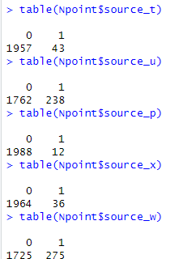
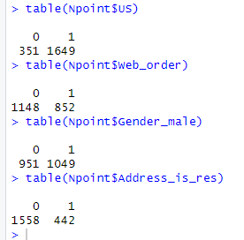
Exploratory Data Analysis Univariate distribution
Spending
Frequency
Last_Update_days_ago
US
Web orders
Gender
Address_is_res
1st_update_days_ago
Source variables distribution

Slide 6
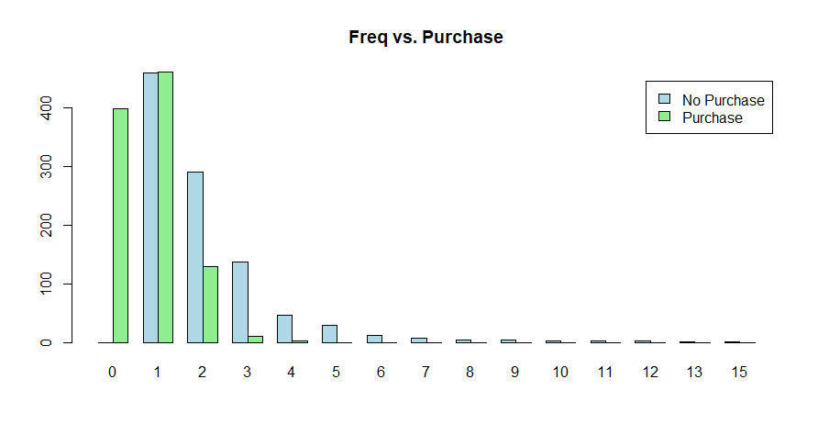
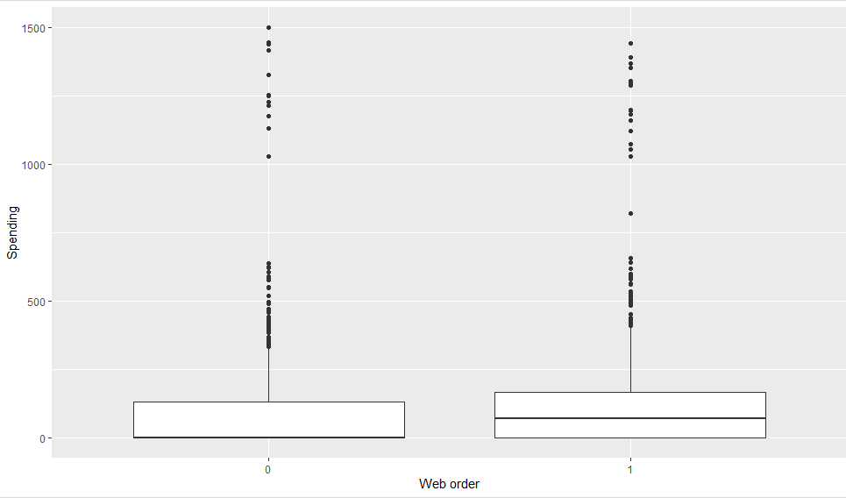
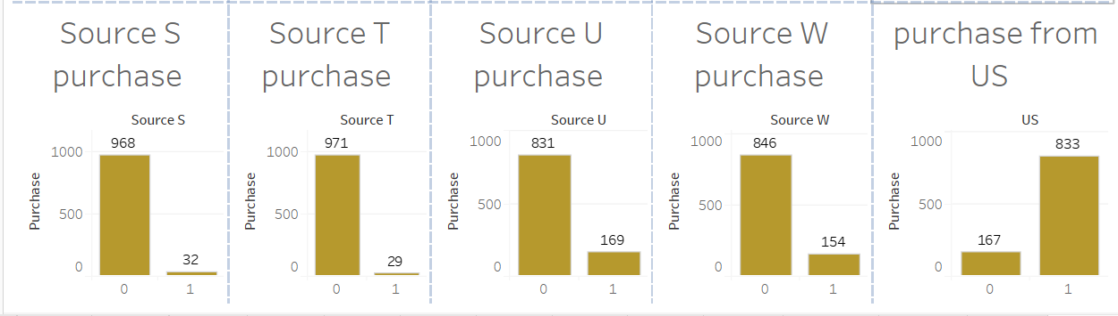
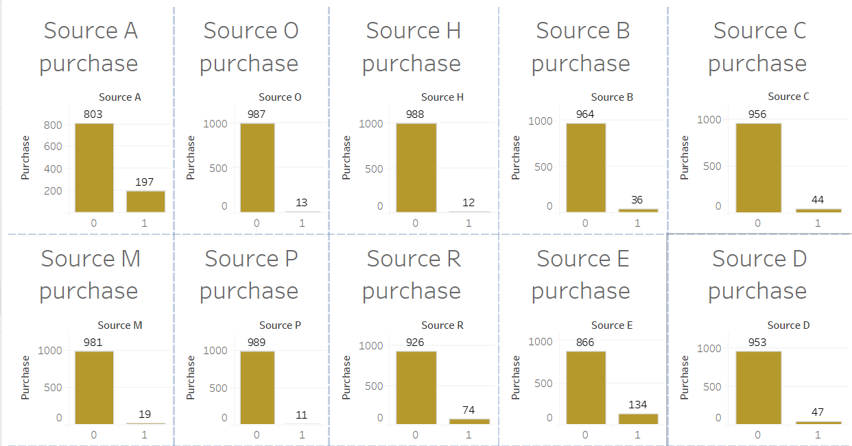
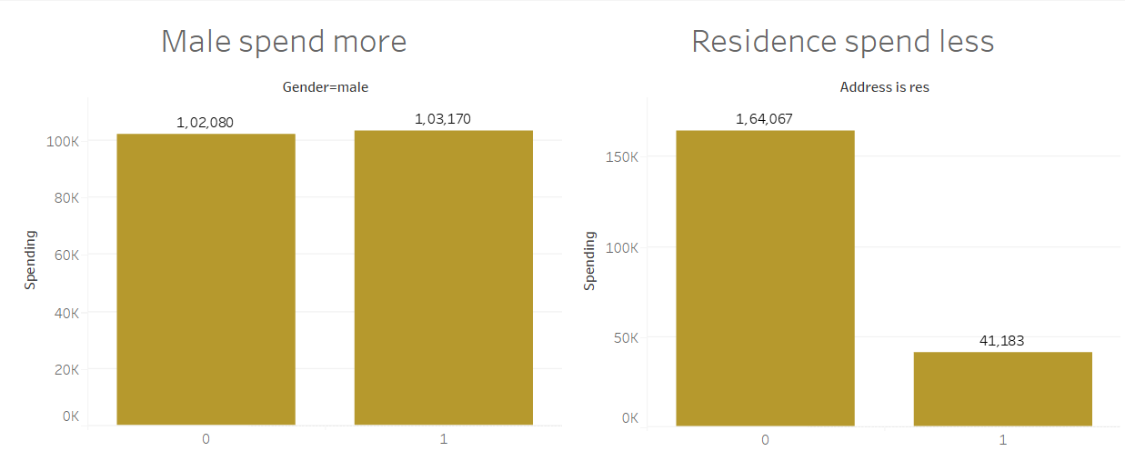
Predictor and outcome variables
Frequency of purchase
spending range of web orders
spending with gender and address is res
Purchase with source variable

Slide 7
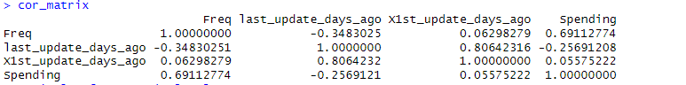
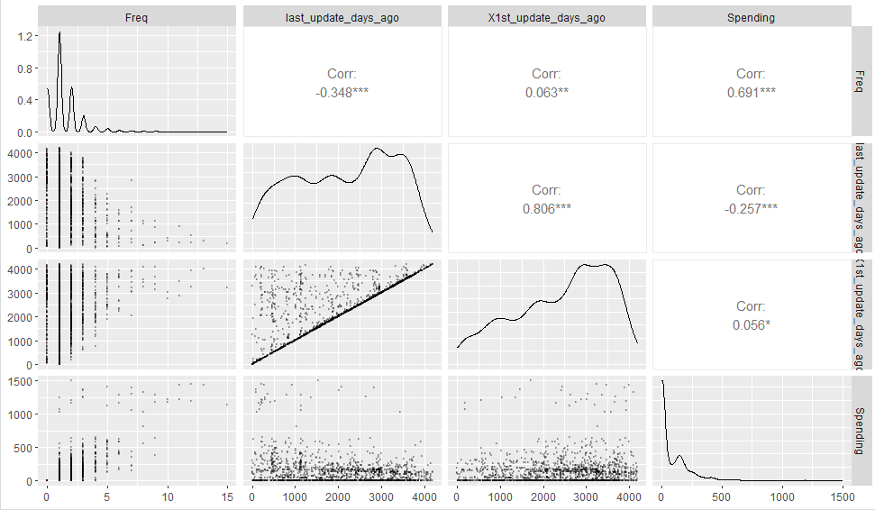
Correlation matrix and pair plot
There is a strong positive correlation between last_update_days_ago and X1st_update_days_ago
The pair plot will display scatterplots of each pairwise combination of numeric variables along with histograms of each variable's distribution along the diagonal.

Slide 8
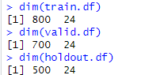
Data partitioning
Training partition:
largest partition, contains the data to build the various models we are examining.
Validation partition:
predictive performance of each model so that we can compare models and choose the best one.
Holdout partition:
will provide an unbiased estimate of how well the model will perform with new data.
Partition data

Slide 9
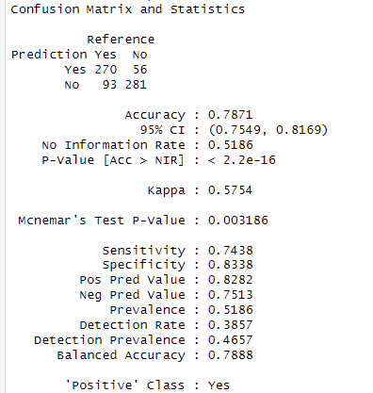
Classifier model
Among all other classification models, we can say that the forward stepwise logistic regression model is the best model with a sensitivity of 74.38%.
The logistic regression model is the probability of a binary outcome as a function of the predictor variables. It gives outputs between 0 and 1, which can be interpreted as probabilities. Of the customer who is buying who is not buying the product

Slide 10
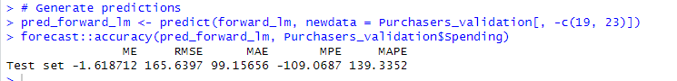
Regression Model
The Forward Stepwise Regression Model is the best model which is approximately 165.6397 with an RMSE value
The RMSE value that is the smallest is crucial for ensuring accurate predictions, particularly in estimating the spending amount of customers who make purchases.

Slide 11
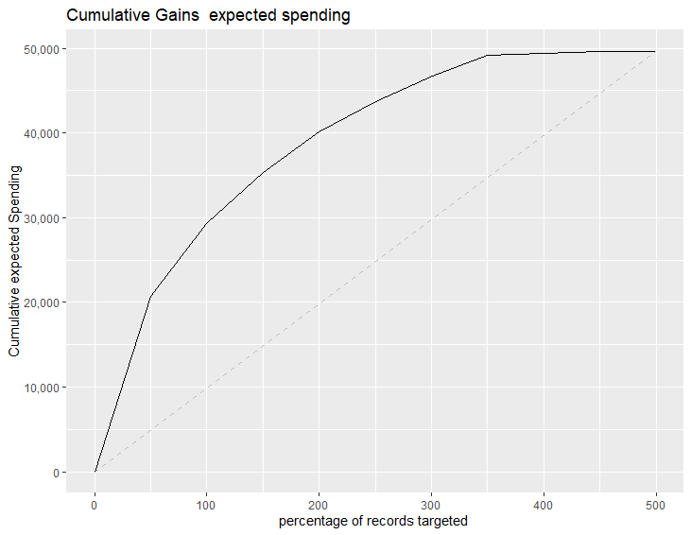
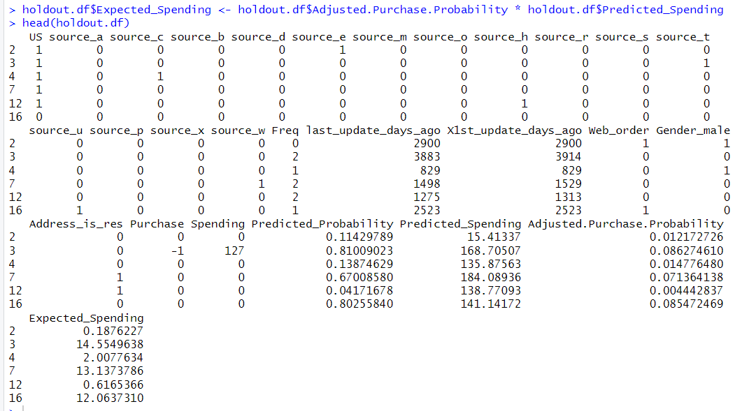
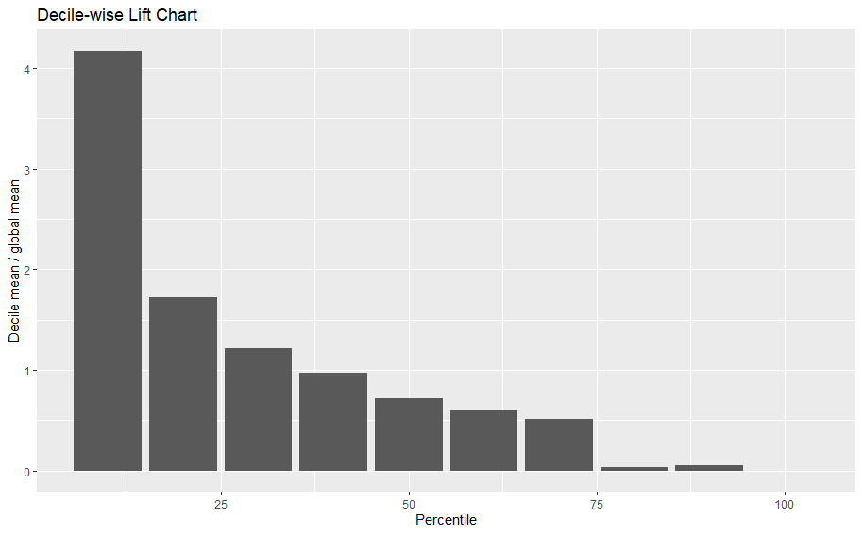
Predictive modeling
cumulative gain chat
Adding predicted probability, predicted spending, adjusted probability of purchase, and expected spending columns and creating cumulative gain chat and Decile-wise lift chart we can see that the mean is 4.17 for 10%
Decile-wise lift chart

Slide 12
Conclusion and suggestions
It is clear from the prediction models and performance rankings that choosing the top 10% of consumers results in a profit that is 4.17 times higher than choosing customers at random.
So, it is advised that the company give preference to choosing the top 10% of clients rather than doing so at random since this approach maximizes return on investment and offers better outcomes.

Slide 13


